Slide 1

Developerparadise
Deytia Lima
Alok Hota
Tyler Plunkett
Kapil Agrawal

Slide 2
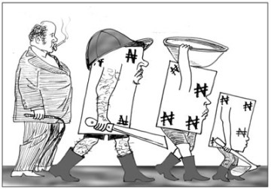

Which picture would you choose?

Slide 3
Agenda
Our business
Our main competitor
Data and Assumptions
Comparisons with our main competitor
Conclusions and Recommendations

Slide 4
OUR BUSINESS
Developer Paradise was founded in 2012
Active number of users: 23,000
Total number of repos: ~78,000

Slide 5
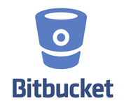
OUR COMPETITOR
Bitbucket was founded in 2008
Manager: Atlassian
Actual number of users: ~1,000,000

Slide 6

General Features
RCS support
We already have an edge on the number of system supported by Bitbucket
Seamless transition for stakeholders using different RCS system.
DevelopersParadise | BitBucket
Git Mercurial Subversion | Git Mercurial

Slide 7




General features
Pricing Model
Current trend shows that DeveloperParadise business model is slowly getting recognized in the community.
Targeting different aspect of service.
DeveloperParadise pricing
Number of repositories 0-5 6-10 11-25 26-50 51-100 > 100 Price free $10 $25 $50 $75 $150
Bitbucket pricing
Number of contributors 0-5 6-10 11-25 26-50 51-100 > 100 Price free $10 $25 $50 $100 $200

Slide 8
Limitations
Access to private repositories is not available
It is hard to comment on size of repositories, there might be a possibility that a repository has more documentation rather than having actual codebase
We can only access users who have at least one repositories
Repositories may not have language information
Access to User information is restricted

Slide 9
Methodology
Initially wanted to crawl Google search results
Results were dynamically generated
Searching would have been slow and tedious
Used Bitbucket API 2.0
Request 100 repositories at a time
Save repository information per users
Cross-analyze repo information
Lots of list comprehensions

Slide 10
Overview
Total number of users
DeveloperParadise – 23,000 (Active)
Bitbucket – 190,098
Total number of repositories (Public)
DeveloperParadise ~78,000
Bitbucket – 416,900
Most popular language
Python – 25,523 (# repo) DeveloperParadise
Python – 44,687* (# repo) Bitbucket
* Not considering unspecified language repositories

Slide 11
Number of repositories per users

Slide 12
Top 10 languages

Slide 13
Overall repo size

Slide 14
Year by year trend

Slide 15
Number of repositories added

Slide 16
Language trends

Slide 17
Conclusions and recommendations
What we saw
What we propose
Python is very popular
Repositories can get big fast
User base grows exponentially
Cater to popular languages
Prepare for heavy network traffic
Prepare for large population

Slide 18

Questions?

